Slide 1


Onion architecture
Amit Naik
Sponsored by

Slide 2
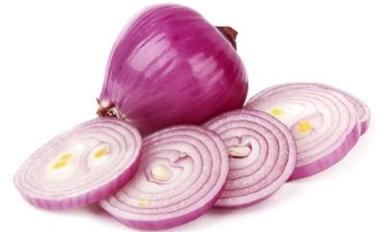
Onion architecture with asp.net core

Slide 3
Agenda
Difference between Desgin pattern, Architecture Pattern & Architecture Style
DATABASE-CENTRIC VS. Domain-centric architecture
What is Onion Architecture
IOC, DI
DDD
Simple Demo project for OA
Real time project on OA
Q & A

Slide 4
Difference between Design pattern, Architecture Pattern & Architecture Style
In simple words
What you want
How you implement
How you solve problem

Slide 5
Difference between Design pattern, Architecture Pattern & Architecture Style
Design pattern | Facotry, Iterator, Singleton
Architecture pattern | MVC, MVP, MVVM, ONION, CLEAN, HEXAGONAL
Architecture style | REST, SOA, IOC

Slide 6
An Architectural Style is the application design at the highest level of abstraction;
An Architectural Pattern is a way to implement an Architectural Style;
A Design Pattern is a way to solve a localised problem.

Slide 7
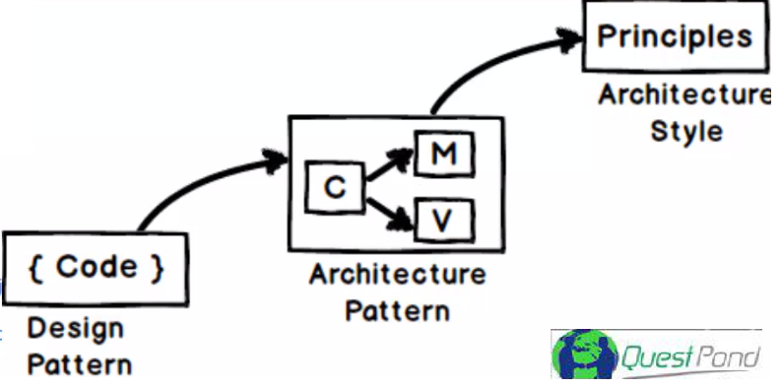

Slide 8
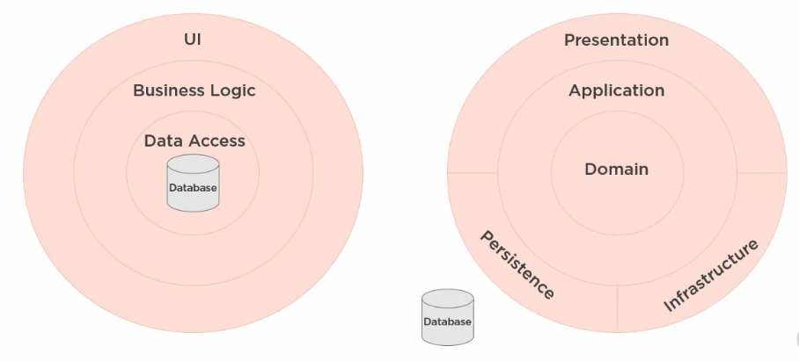
DATABASE-CENTRIC VS. Domain-centric architecture

Slide 9
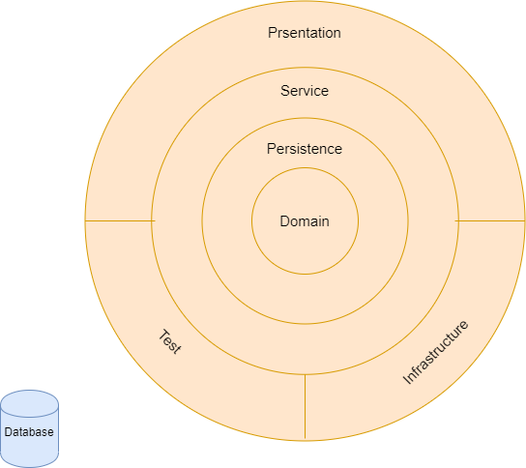
Onion architecture

Slide 10
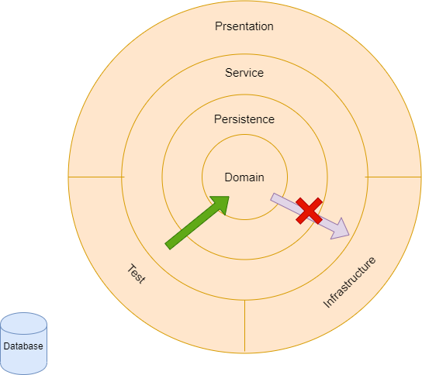

Slide 11
Onion, CLEAN & Hexagonal arch.
https://jeffreypalermo.com/2008/07/the-onion-architecture-part-1/
https://blog.cleancoder.com/uncle-bob/2012/08/13/the-clean-architecture.html
https://alistair.cockburn.us/hexagonal+architecture

Slide 12
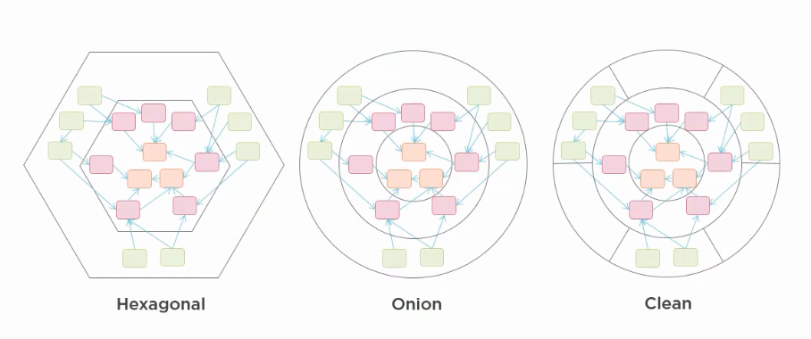
It’s all same thing
https://blog.ploeh.dk/2013/12/03/layers-onions-ports-adapters-its-all-the-same/

Slide 14
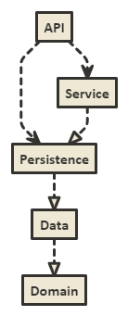

Slide 15
Project demo

Slide 16
Thanks
Shivaprasad Koirala
Sukesh Marla
Pradeep Shet
Dhiraj Poojary

Slide 17
Thank you

